Slide 1
Working in the Analog Domain
(DACs and ADCs)
  Introduction
  R-2R Resistor DAC Theory & Operation
  ADC Technology : Successive Approximation ADCs
  Data Acquisition Systems
  Sample & Hold Circuits
  Multiplexers
  Signal Conditioning Circuits
©Paul Davies. Not to be copied, used, or revised without explicit written permission from the copyright owner.
This lecture may contain animations and is best viewed as a slide show

Slide 2
Introduction
There exists in the real world, a large class of applications that cannot be driven simply by digital means alone.
Such systems require that a computer be able to work with representations of the signals as they occur in the real world i.e. via analog voltages & currents etc.
A means must exist therefore to convert such signals from their Analog representation into a digital form suitable for processing via numerical algorithms and back again into an Analog output to the real world.
Such conversions are handled in hardware by
  Analog to Digital Converters (ADC’s) and
  Digital to Analog Converters (DAC’s)

Slide 3
The illustration below shows a typical functional block diagram of a simple digital signal processing system for capturing and processing real-world analog signals.
These signals enter the system where they are converted (i.e. sampled) by an ADC into a digital representation of their amplitude at the instant when they are sampled.
The signal (the set of digital samples) is processed by an algorithm in the computer before the resulting digital output (the response) is converted back to an analog signal by a DAC.
Digital
In
Digital
Out
Analog
Input
ADC
CPU
DAC
Analog
Output
ADC
CPU
DAC
Typical Data Flow Model of a DSP system

Slide 4
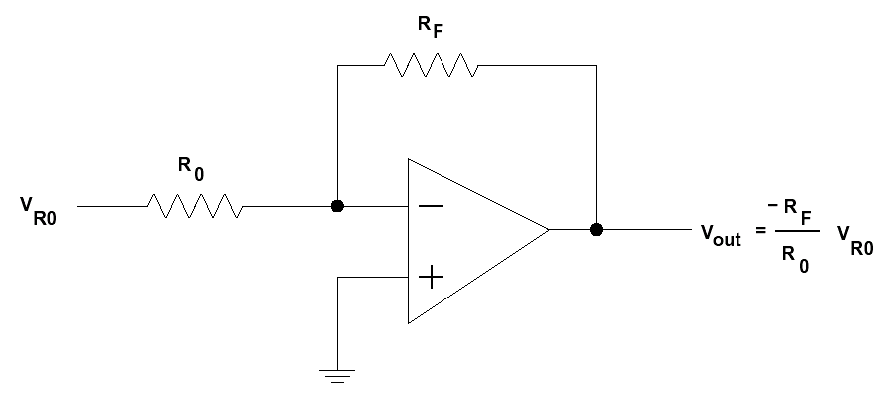
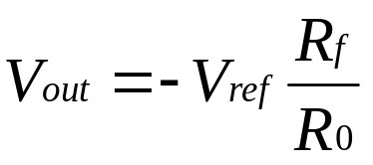
Digital to Analog Converters (DAC’s)
DACs are often a key component of Analog to Digital converters (ADCs) so an understanding of how they work here will help us later with the ADC.
Inverting Op-Amps can easily be used to create a DAC by connecting as shown below.
Varying R₀ alters gain of op-amp and hence the voltage V_{out}
Recall from your circuits class that in this inverting configuration, the op-amp maintains a virtual earth (i.e. 0v) at it’s ‘-’ input because it subtracts the difference between its ‘+’ (here connected to ground) and ‘-’ inputs.
To convert this circuit into a DAC, we only need a precision voltage V_{ref} and a digital switch able to select different values for R₀ to alter gain and hence V_{out}.
An Op-Amp configured like this, outputs a voltage such that the difference between its two inputs is always 0, thus the ‘-’ input is always at 0v and represents a virtual earth
Output voltage affected by changes in R₀
V_{ref} is a fixed precision voltage e.g. -5v
+12v
V_{ref}
-
+
Changing R₀ alters the gain of the Op-Amp and thus the output voltage for a fixed input voltage V_{ref}
-12v
0v

Slide 5
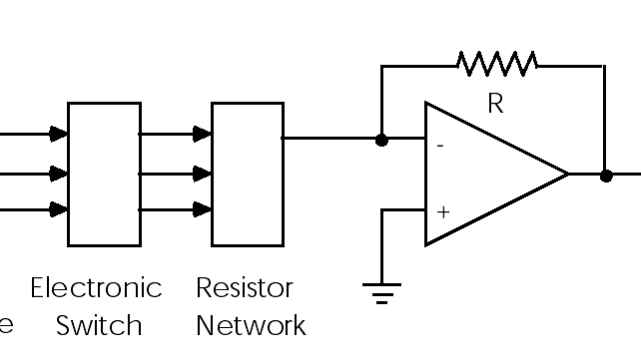
DAC Block Diagram
The circuit below represents a block diagram for a typical DAC.
To the computer, the DAC appears as a parallel digital port whose data width depends upon the DAC itself. Common sizes include 8, 12, 16 bits etc.
The digital input data activates solid state electronic switches which are used to select resistors (R₀) from the network.
These affect the gain of the Op-amp and achieve the particular output voltage.
Switches select various resistors from network based on Digital input and alter Gain of the op-amp
Resistor Network able to be switched for different values of R₀
-V_{ref}
R_{F}
{
Parallel Digital input to select values for R₀
-
R₀
Voltage Output
+
Electronic Solid-State Switches
Resistor Network

Slide 6
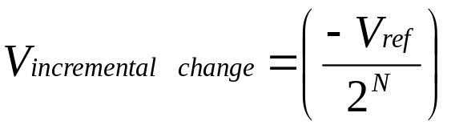
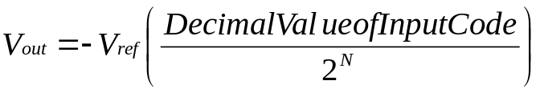
Transfer Function of a 4 Bit DAC
Actual “Staircase” Transfer Function of 4 Bit DAC
Voltage Output
Idealised Transfer Function
-15V_{ref}/16
4 bit DAC divides V_{ref} into 2⁴ voltage steps
The more bits we have, the closer to the idealised transfer function the DAC becomes and the closer we get to achieving V_{ref} as an output from the DAC
-14V_{ref}/16
-13V_{ref}/16
-12V_{ref}/16
-11V_{ref}/16
-10V_{ref}/16
-9V_{ref}/16
-8V_{ref}/16
-7V_{ref}/16
-6V_{ref}/16
-5V_{ref}/16
-4V_{ref}/16
-3V_{ref}/16
-2V_{ref}/16
-V_{ref}/16
0V
0v Out for [0000] In
0000
0001
0010
0011
0100
0101
0110
0111
1000
1001
1010
1011
1100
1101
1110
1111
4 bit Digital Input Code

Slide 7
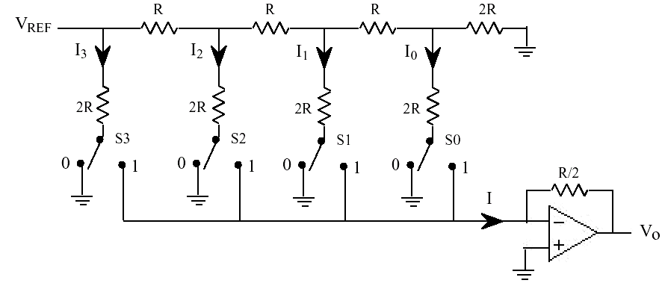
The R-2R Type DAC
The most common DAC implementations use an R-2R resistor network. Note how the feedback resistor R_{f} has the value R.
Because only one value of resistor is used (the R is formed by placing a pair of 2R resistors in parallel) on a chip, then the temperature sensitivity and precision of these resistors will all be similar, leading to a high quality DAC.
The electronic switches on the digital input, connect a path in the resistor network either to the real ground or the virtual ground. The current I entering the Op-Amp depends on the switch “positions”. Either way, the same current flows in the network regardless of switch positions, leading to a more stable PSU load and V_{REF}
-V_{REF} / 2
-V_{REF} / 4
-V_{REF} / 8
4 Bit DAC
-
R
R
R
2R
-V_{REF}
I₃
I₂
I₁
I₀
These resistors effectively in parallel (regardless of switch positions) due to Virtual Earth and Real Earth at Op-Amp.
2R
2R
2R
2R
S₃
S₂
S₁
S₀
R
I
-
+
V_{out}
Virtual Earth at 0v

Slide 8
The R-2R Type DAC
Equivalent Circuit (assuming Digital Input = [1100] or decimal 12)
-V_{REF}
At each network Node, the combined resistance of the network looking from V_{ref} towards ground is always ‘R’, regardless of the position of the switches. With Binary [1100] presented to the DAC, the currents that flow into the Op-Amp are
  I = I₃ + I₂
  I = -V_{REF} /2R + (V_{REF} / 2)/2R
  I = -V_{REF} (1/2R + 1/4R)
  I = -V_{REF} (3/4R)
Thus the equivalent resistance R₀ required to generate the current I when connected to V_{REF} is
R₀ = V/I = -V_{ref}/[-V_{ref} (3/4R)] = 4R/3
Thus the gain of the Op-amp is (-R_{f} / R₀) = -3/4 leading to a V_{out} of -0.75 V_{REF}
i.e. V_{out} = - V_{REF} * 12/16
-V_{REF}
R
-V_{REF} / 2
2R
R
-V_{REF} / 4
2R
R
-V_{REF} / 8
2R
2R
2R
I₃
I₂
I₁
I₀
Virtual (Op-Amp) 0v
Real 0v

Slide 9
The R-2R Type DAC
Equivalent Circuit (assuming Digital Input = [1111] i.e. decimal 15)
-V_{REF}
At each Node, the combined resistance of the network looking from V_{ref} towards ground is always ‘R’, regardless of the position of the switches. With Binary [1111] presented to the DAC, the currents that flow into the Op-Amp are
  I = I₃ + I₂ + I₁ + I₀
  I = -V_{REF} /2R + ……... + (V_{REF} / 8)/2R
  I = -V_{REF} (1/2R + 1/4R + 1/8R + 1/16R)
  I = -V_{REF} (15/16R)
Thus the equivalent resistance R₀ required to generate the current I when connected to V_{REF} is
R₀ = V/I = -V_{ref}/[-V_{ref} (15/16R)] = 16R/15
Thus the gain of the Op-amp is (-R_{f} / R₀) = -15/16 leading to a V_{out} of -0.9375 V_{REF}
i.e. V_{out} = - V_{REF} * 15/16
-V_{REF}
R
-V_{REF} / 2
2R
R
-V_{REF} / 4
2R
R
-V_{REF} / 8
2R
2R
2R
I₃
I₂
I₁
I₀
Virtual (Op-Amp) 0v
Real 0v

Slide 10
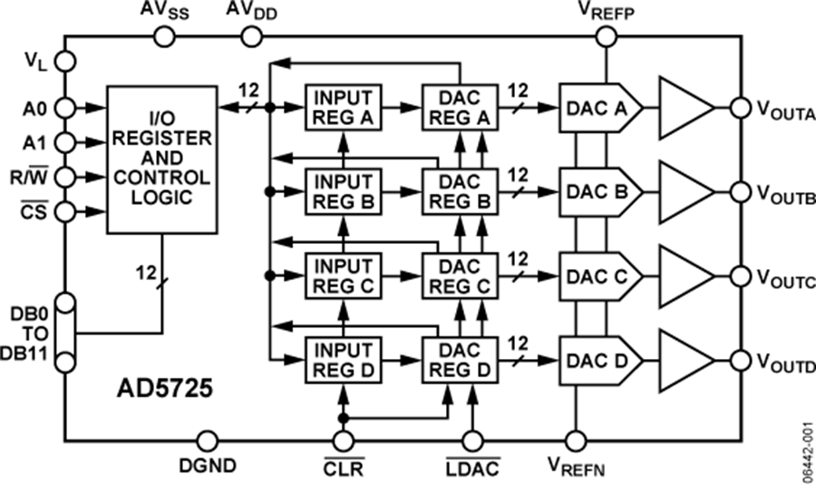
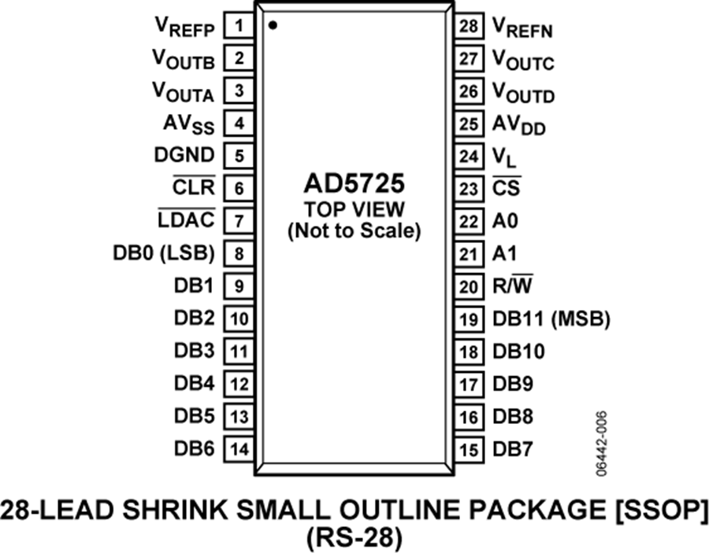
Interfacing Techniques
Generally speaking DAC’s are very easy to interface. Most are either Parallel Port devices, or are designed to be used as a memory mapped peripheral, i.e. they represent an output port that the CPU can write to.
Others may be driven using serial bit streams such as SPI or I²C.
A good source of DAC literature and specifications can be found at Analog devices and Burr Brown (now owned by Texas Instruments)
Analog Devices AD5725 – Quad 12 Bit DAC with Parallel CPU Interface

Slide 11
Analog to Digital Converters
An Analog-to-Digital converter (ADC) can be used to convert an analog input voltage into a digital representation, i.e. an ‘N’ bit binary number, that can be processed by a computer.
Typical Analog Sensors include:-
  Light e.g. daylight and Infrared
  Temperature, e.g. Thermocouples and LM34 chip
  Strain Gauges,
  Movement and rotation using Potentiometers,
  RPM,
  Accelerometers,
  Pressure, Fluid Level, Humidity and Flow rate,
  PH for acidity etc.

Slide 12
Waveform Digitising using an ADC
An analog waveform is sampled by measuring it’s amplitude at an instant in time.
Each sample is converted to an 'N' bit wide code word by the ADC.
IMPORTANT: The N bit wide code word is a representation of the amplitude expressed as a fraction of some fixed reference voltage V_{ref} e.g. ½ V_{ref}, 2/3^{rds} V_{ref} etc.
By sampling at a fixed time interval D_{t} we could build up a table of sampled values approximating the waveform, as used in a recording studio to capture music.
D_{t}
Analog waveform
Amplitude
TIME
Instantaneous Amplitude
e.g. -3 volts = [10110100]
Example signed (2’s complement) , 8 bit "code word" representing amplitude at time of sampling.

Slide 13
Transfer Function of a typical 3 Bit ADC
Voltage Input
Actual Input Voltage
Digital Output Code
V_{ref}
111
A 3 bit ADC divides V_{ref} into 2³ distinct voltage bands.
Example: Any input voltage between 5V_{ref} /8 and 6V_{ref} /8 will be converted to [101]
Example: Any input voltage between V_{ref} /8 and 2V_{ref} /8 will be converted to [001]
7V_{ref}/8
110
6V_{ref}/8
101
5V_{ref}/8
100
4V_{ref}/8
011
3V_{ref}/8
010
2V_{ref}/8
001
V_{ref}/8
000
0V
Time

Slide 14
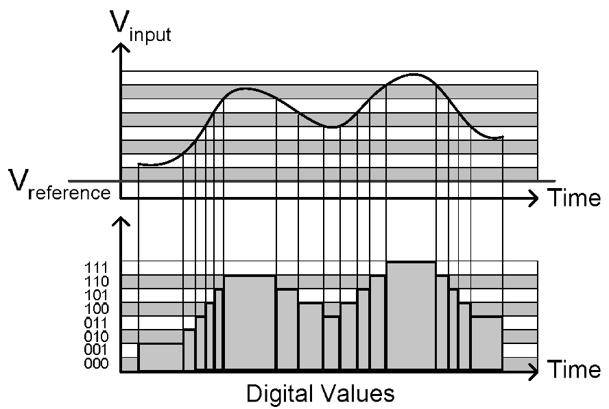
V_{in}
Example 3 bit ADC Conversion
5v
4.375v
3.125v
2^{N} – 1 voltage bands
1.875v
0.625v
0v
111
110
Output from ADC
101
100
011
010
001
Time
000
Output of a 3 bit ADC assuming V_{ref} = 5v
Assume V_{ref} = 5v
Digital Code | Input Voltage Range
000 | 0 <= Vin < 0.625
001 | 0.625 <= Vin < 1.25
010 | 1.25 <= Vin < 1.875
011 | 1.875 <= Vin < 2.5
100 | 2.5 <= Vin < 3.125
101 | 3.125 <= Vin < 3.75
110 | 3.75 <= Vin < 4.375
111 | 4.375 <= Vin < 5.0

Slide 15
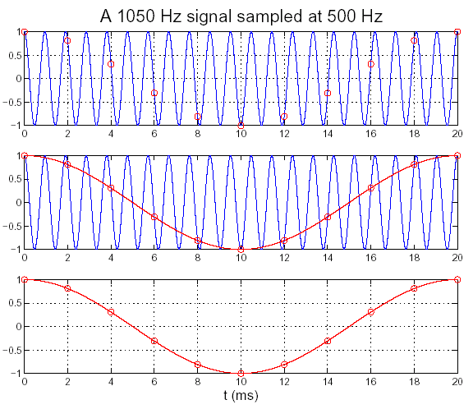
The Importance of ADC Sampling Rates
When sampling a signal, care must be taken to ensure that the signal is sampled at a sufficiently high rate that the signal’s shape and frequency are captured accurately.
Example
Consider the graph opposite where a 1050Hz signal is being sampled at 500 Hz, i.e. less than half the frequency of the input signal.
The ADC samples the signal at the points identified by the red circles.
By interpolating between the samples, the software could be confused into believing that the original signal was only 50Hz.
Ideally you should sample a signal at a rate of at least twice the highest frequency you want to capture
As an example, Audio CD’s are created by sampling the original signal at 44.1Khz which is more than twice the range of frequencies detectable by the human ear (~20KHz)
Real systems may sample at a rate of four times the highest frequency component.

Slide 16
A Review of Analog Comparators
A comparator is a fundamental building block of all ADCs usually constructed from an Op-Amp.
It is a simple device that compares two input voltages and asks:-
“is my ‘+’ input voltage bigger (or smaller) than my ‘-’ input ?”
The op-amp works by amplifying the difference between it’s two inputs, thus, if the voltage on the ‘+’ input is greater than the voltage on the ‘-’ input, then due to the very high open loop gain of the op-amp, the output voltage will be V_{cc}, (i.e. logic 1)
If however the voltage on the ‘+’ input is less than or equal to the voltage on the ‘-’ input, the output will be 0 volts (i.e. logic 0).
V_{out} = V_{cc} (Logic 1) when V_{in} > V_{REF}
V_{out}
V_{cc}
V_{cc}
V_{in}
V_{REF}
-
V_{REF}
V_{out}
V_{IN}
+
0v
0v
V_{out} = 0v (Logic 0) when V_{in} <= V_{ref}

Slide 17
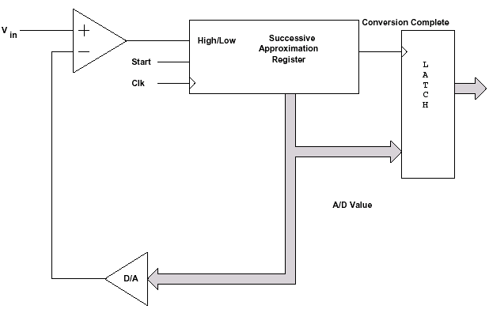
Successive Approximation ADC’s
There are many ways to implement an ADC, each with various speed, cost, resolution trade-offs e.g. Flash, Integrating, Tracking ADCs etc. A supplementary lecture posted on Canvas takes a look at these other methods, but it is not part of the course for this year.
The successive approximation ADC is the most popular type of ADC used in Microcontrollers (uCs), in fact many uCs have them built in.
The conversion time of this type of ADC is always consistent and predictable regardless of input signal amplitude and is cheap and simple to make as it’s mostly digital.
This type of ADC consists of an ‘N’ bit wide register, whose bits can be set or cleared independently of each other, usually under the control of a state machine, which controls the conversion.
It operates by guessing the input voltage and comparing that guess with the real input voltage. Based on that comparison, it refines it's guess until it converges on a guess that is as close as possible to the real voltage.
0 means guess too high
1 means guess too low
Register Preload
1 0 0 0 0 0
V_{in}
+
Complete
-
6-Bit
SA Register (SAR)
L
A
T
C
H
N bit Output
Start
CLK
Voltage Guess
N-bit Latch
V_{DAC}
DAC
6-bit DAC
6-Bit Successive Approximation ADC

Slide 18
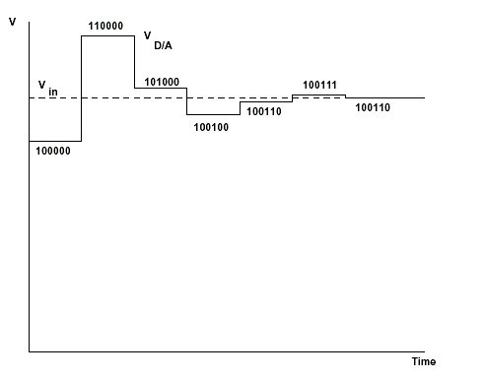
Detailed Operation for a 6 Bit ADC
Initially, the 6 bit SAR is set to 100000, i.e. we start with the most significant bit of the SAR
This is the 1st guess, i.e. that V_{in} = ½ V_{ref}
The SAR feeds a DAC which outputs the voltage guess which is compared to V_{in}.
  If the guess was too low, the output from the comparator will be ‘1’.
  If the guess was too high, the output from the comparator will be ‘0‘.
Either way, the output of the comparator (0 or 1) is stored in that bit of the SAR.
Next, the ADC makes a 2nd more refined guess by setting the next bit in the SAR to a logic 1.
The above process is repeated until all ‘N’ bits in the SAR have been determined. At this point the DAC voltage converges on the closest guess to V_{in}.
This conversion process always takes 6 clocks of a state machine (for a 6 bit ADC) and at the end, the SAR holds the 6 bit result.
1 means guess too low
0 means guess too high
Register Preload
1 0 0 0 0 0
V_{in}
+
Complete
-
6-Bit
SA Register (SAR)
L
A
T
C
H
N bit Output
Start
CLK
Voltage Guess
V_{ref}
N-bit Latch
V_{DAC}
DAC
6-bit DAC
6-Bit Successive Approximation ADC
Voltage Guess Waveform

Slide 19
Data Acquisition (DAQ) Systems
Sensors
DAQ
DSP
DAC
Actuators
Sensors
DAQ
DSP
DAC
Actuators
S/H
S/H
S/H
S/H
ADC
FIFO
CPU
Interface
ADC
FIFO
CPU
Interface
Analog
Mux
S/H
S/H
S/H
S/H
Sensors
Signal
Conditioning
Anti -
Aliasing
Filters

Slide 20
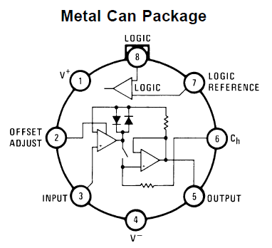
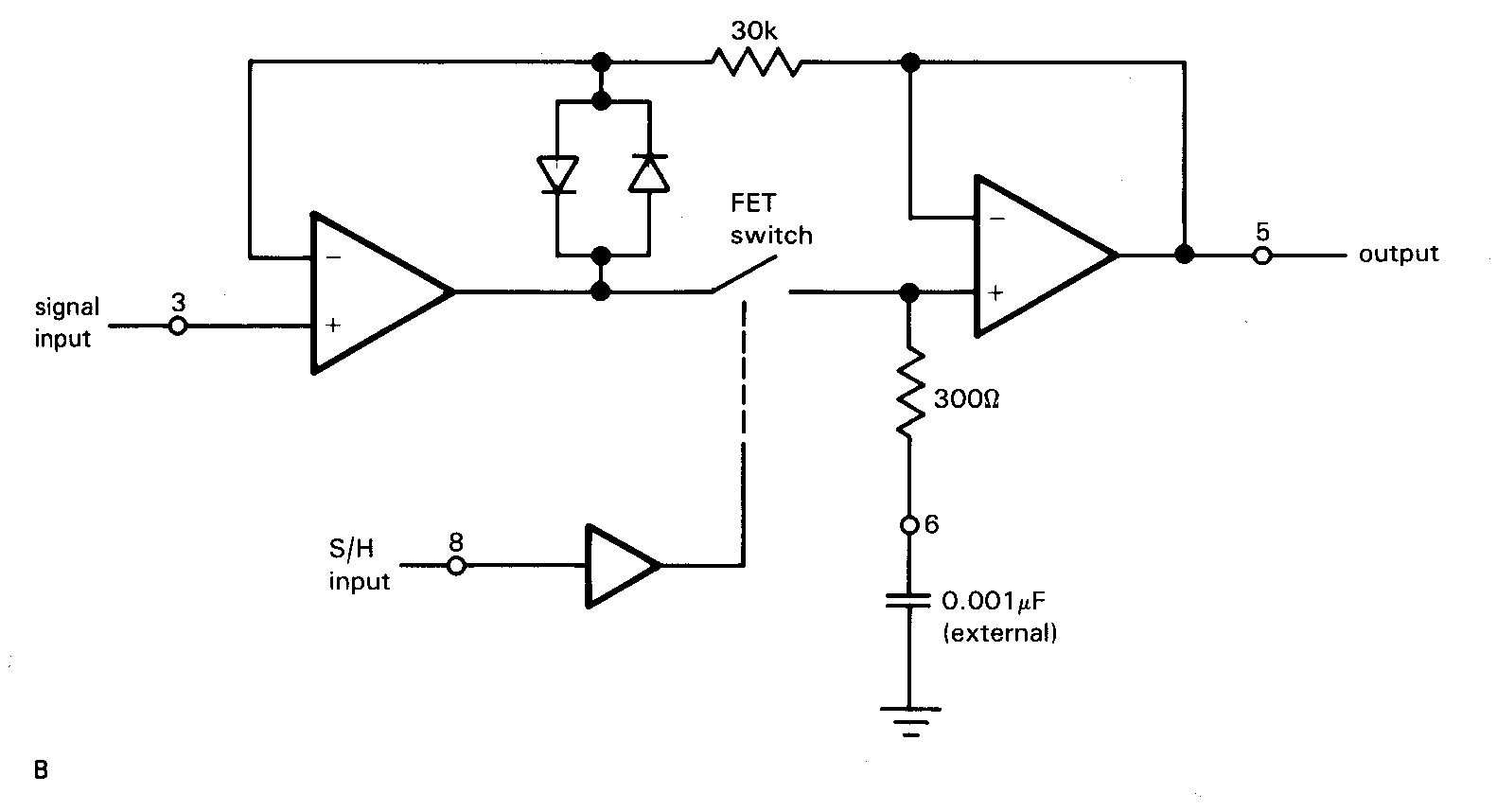
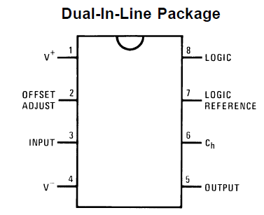
Sample & Hold Circuits (S/H)
These circuits present a stable voltage to the ADC while it is being converted.
National Semiconductor (among others) make S/H chips such as the LF198
A digital input controls a FET switch which first connects an (external) capacitor to V_{in} which rapidly charges to that voltage. This is the Sample phase.
Once charged, the FET switch is opened and the charge on the capacitor remains constant while a conversion takes place within the attached ADC.
However, capacitors being what they are, the charge will inevitably leak away slightly if the conversion process is slow.
A capacitor value is chosen to match the conversion speed of the ADC, i.e. small value for fast charging at a high sampling rate.
Input Impedance 10¹⁰ ohms
-
-
V_{out}
+
V_{in}
+
Sample/Hold Input
8
National Semiconductor
LF198

Slide 21
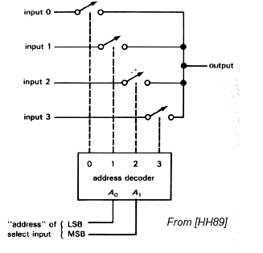
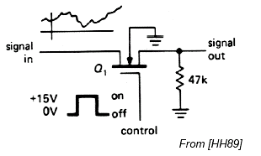
Multiplexed Inputs
An analog multiplexer permits selection of a choice of analog sources and are commonly used when it is necessary to convert many signals with a single ADC (one at a time).
FET Analog Switches
Analog switches are often constructed using ‘N-channel enhancement-mode MOSFETs’
When the Gate is grounded, or negative, the FET is non-conducting
  Drain-source resistance is then of the order of 10,000M ohms (open circuit).
Applying a suitable positive voltage to the Gate allows the drain-source channel to conduct
  Drain-source resistance is then of the order of < 1 ohm.
4 Analog Switches
FET Switch
Input 0
Input 1
4 Analog Inputs
Analog Out
Input 2
Input 3
0
1
2
3
2-4 Line Decoder
A₀
A₁
2 Bit Digital Channel Select Input
Example: Analog Devices ADG804
FET Switch

Slide 22
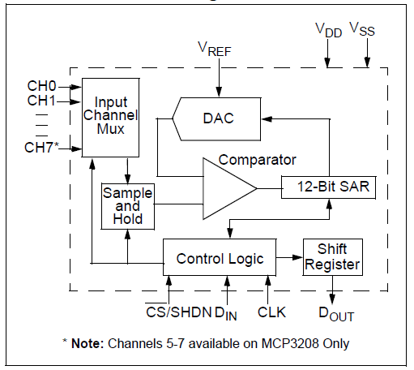
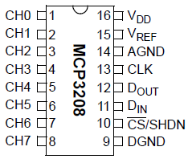
MCP3208 - 8 Channel, 12 bit Successive Approximation ADC
with SPI bus interface, built in Mux, Internal DAC and S/H circuit

Slide 23
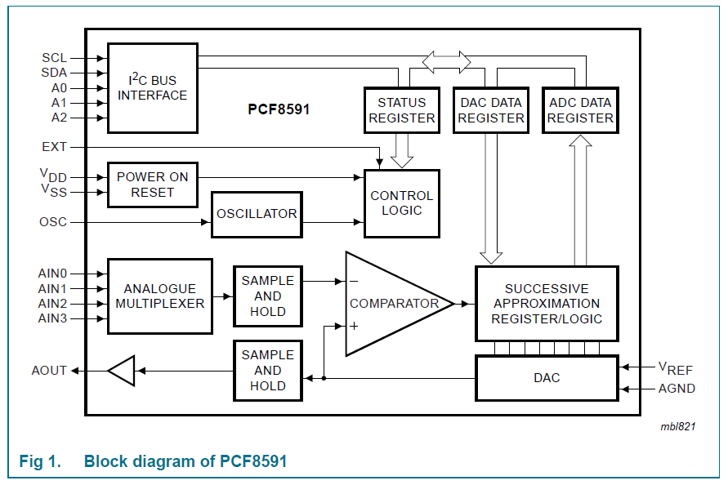
Used in Lab 5
PCF8591 - 4 channel 8-bit Successive Approximation ADC plus single channel DAC with IIC bus interface

Slide 24
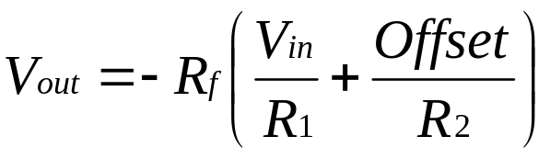
Signal Conditioning.
As you can imagine, there are a wide range of analog sensors and transducers that can be interfaced to a computer with an appropriate ADC.
However, not all of them produce voltage outputs that are in the ideal range to work with ADC’s some only produce milli-volts and/or negative voltage outputs.
Such sensors will need signal conditioning circuits to scale and/or shift their voltage levels.
The circuit opposite is that of a summing amplifier (like the DAC we looked at previously which can be used to both shift the level of a sensor signal V_{in} by adding an offset to the output and amplify the signal magnitude by changing the ratio of R_{f} relative to R₁ and R₂.
R_{f}
R₁
V_{in}
+12v
R₂
-
V_{out}
Offset
+
-12v
A Level Shifter and Amplifier

Slide 25
Example: Interfacing a Temperature Sensor
The LM34 is a precision Fahrenheit temperature sensor with +/- 0.5 degree accuracy
The voltage output is linearly proportional to the temperature.
V_{out} = -440mV @ -44 deg F rising to 2120mV @ 212 deg F
It has three signal pins: V_{out} for output voltage, V_{s} and GND for power.
A typical circuit for connecting an LM34 to an ADC is given below.
Output voltage in range (+0.4) to (-2.12)
10k
Output voltage in range 0.1v @ -44F to
4.9v at +212F
+5v
+12v
8.2k
+2120mv at 212F
+750mv at 75F
-440mv at -44
LM34
10k
-
4.3k
+12v
+
47k
-
To ADC
0v
+
-12v
-5v
-12v
Inverting Voltage Follower with Gain of (-1)
Inverting Level Shifter and Amplifier

